Slide 1
Thursday, September 1, 2016
Write In Your Agenda:
Write In Your Monitoring Log:
CW:
The Earth’s Layers Foldable
HW:
Study for quiz on Friday 9/2
Response to Warm-Up:
Where do convection currents occur? Why?
You will need:
Pencil

Slide 2
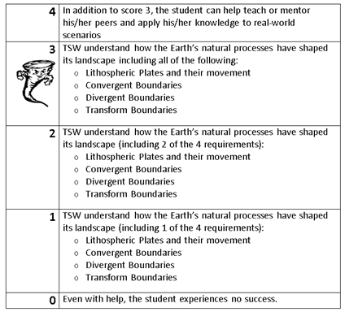
Learning Goal and Scale
TSW understand how the Earth’s natural processes have shaped its landscape (including Lithospheric Plates and their movement, Convergent, Divergent, and Transform boundary landforms).

Slide 3
https://www.youtube.com/watch?v=jkKlGXG4lG8

